Slide 1
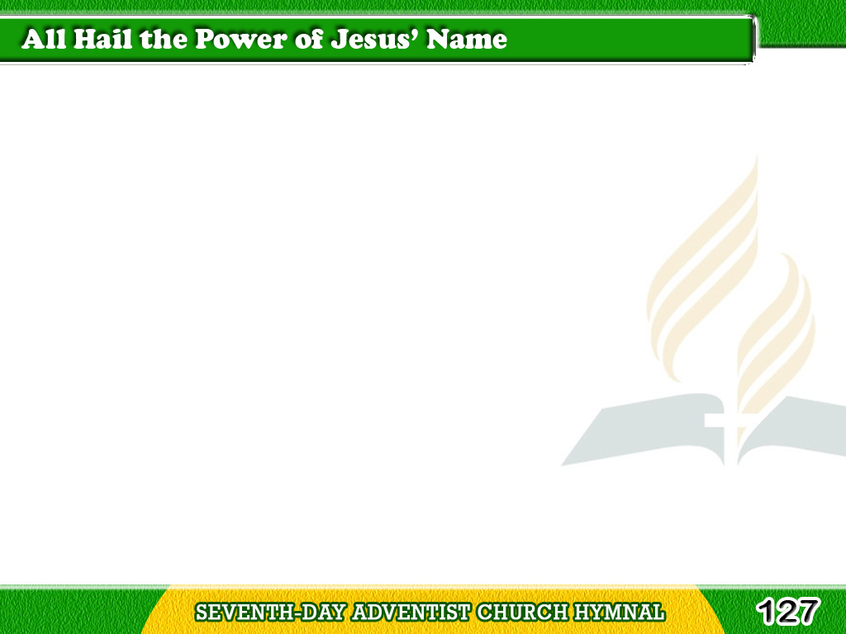

1/4
All hail the power
of Jesus’ name!
Let angels prostrate fall;
Bring forth the royal diadem,
Tagalog
Version

Slide 2
1/4
And crown Him Lord of all!
Bring forth the royal diadem,
And crown Him Lord of all.
Tagalog
Version

Slide 3
2/4
Ye seed of Israel’s chosen race,
Ye ransomed of the fall,
Hail Him who saves you
by His grace,
Tagalog
Version

Slide 4
2/4
And crown Him Lord of all!
Hail Him who saves you
by His grace,
And crown Him Lord of all.
Tagalog
Version

Slide 5
3/4
Let every kindred, every tribe,
On this terrestrial ball,
To him all majesty ascribe,
Tagalog
Version

Slide 6
3/4
And crown Him Lord of all!
To Him all majesty ascribe,
And crown Him Lord of all.
Tagalog
Version

Slide 7
4/4
Oh, that with yonder
sacred throng
We at His feet may fall,
Join in the everlasting song,
Tagalog
Version

Slide 8
4/4
And crown Him Lord of all!
Join in the everlasting song,
And crown Him Lord of all.
Tagalog
Version

